Slide 1
NE 591: Advanced Reactor Materials
Fall 2021
Dr. Benjamin Beeler

Slide 2
molten salts

Slide 3
Molten Salt Reactors
Salt Cooled Reactor
Driven by some traditional fuel type in cladding, where the coolant is replaced with molten salt
Static Salt Fueled Reactor
The fuel itself is a liquid actinide-salt mixture contained in a cladding, often coupled with a salt coolant
Flowing Salt Fueled Reactor
The fuel itself is a liquid actinide-salt mixture which flows in a loops through the core and doubles as the coolant

Slide 4
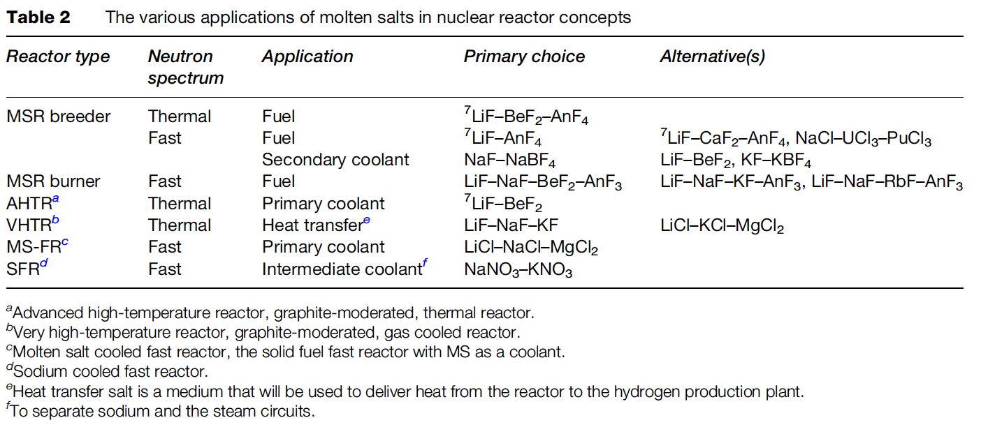
Molten Salt Applications

Slide 5
Benefits of MSRs
MSRs operate at or close to atmospheric pressure, rather than the 75-150 times atmospheric pressure of typical light-water reactors (LWR)
This reduces the large, expensive containment structures used for LWRs
Radioactive fission gases can be naturally absorbed into the molten salt
MSRs can have higher operating temperatures than a traditional LWR, providing higher electricity-generation efficiency, the possibility of grid-storage facilities, economical hydrogen production and, in some cases, process-heat opportunities.

Slide 6
Challenges of MSRs
The corrosivity of hot salts can break down cladding components and leech alloying elements
The changing chemical composition of the salt as it is transmuted by reactor radiation leads to changing properties
The processing of liquid transuranium molten salt fuel from the current spent fuel and of the on-line reprocessing of MSR fuel need to be solved

Slide 7
Beginning of MSRs
Aircraft Reactor Experiment was a 2.5 MWth thermal-spectrum nuclear reactor experiment designed to attain a high power density and high output temperature for use as an engine in a nuclear-powered bomber aircraft
It used the molten fluoride salt NaF-ZrF4-UF4 (53-41-6 mol%) as fuel, was moderated by a hexagonal-configuration beryllium oxide (BeO), and had a peak temperature of 860C

Slide 8
MSRE
The Molten-Salt Reactor Experiment (MSRE) was an experimental molten salt reactor at the Oak Ridge National Laboratory (ORNL); constructed by 1964, it went critical in 1965 and was operated until 1969

Slide 9
MSRE
MSRE was a circulating fuel type, utilizing LiF-BeF₂-ZrF₄-UF₄
The secondary coolant salt was LiF-BeF₂ (FLiBe), and the moderator was graphite
Salt-facing component were made of Hastelloy-N, which is a low chromium, nickel–molybdenum alloy

Slide 10
Neutron Economy
Thermal spectrum molten salt fuels were identified as candidates for breeding (converting fertile into fissile), specifically in the thorium fuel cycle
Li-Be-F salts were selected because of the low thermal neutron cross sections of ⁷Li (σ_{th} = 0.045 b) and Be (σ_{th} =0.0088 b)
Natural lithium cannot be used as part of the nuclear fuel as it contains about 7.6% of ⁶Li (the remaining 92.4% is ⁷Li), which has a very high parasitic neutron capture cross-section (σ_{th} = 940 b)
Therefore, enrichment of ⁷Li is required before it can be used in the core

Slide 11
Fast Spectrum MSRs
Current MSR designs move away from thermal graphite-moderated concepts, and favor non-moderated concepts that have a fast(er) neutron spectrum and can function to burn radioactive waste
Fuel selection for the non-moderated reactor concepts is more flexible, and elements other than ⁷Li can be considered
The neutron capture cross-section of the alkali halides and alkali-earth halides is generally lower in the ‘fast’ spectrum than in the thermal spectrum
Compounds like NaF, KF, RbF, or CaF2 can be considered as part of the fuel matrix
There are also some ‘fast’ MSR concepts which are based on chloride salts

Slide 12
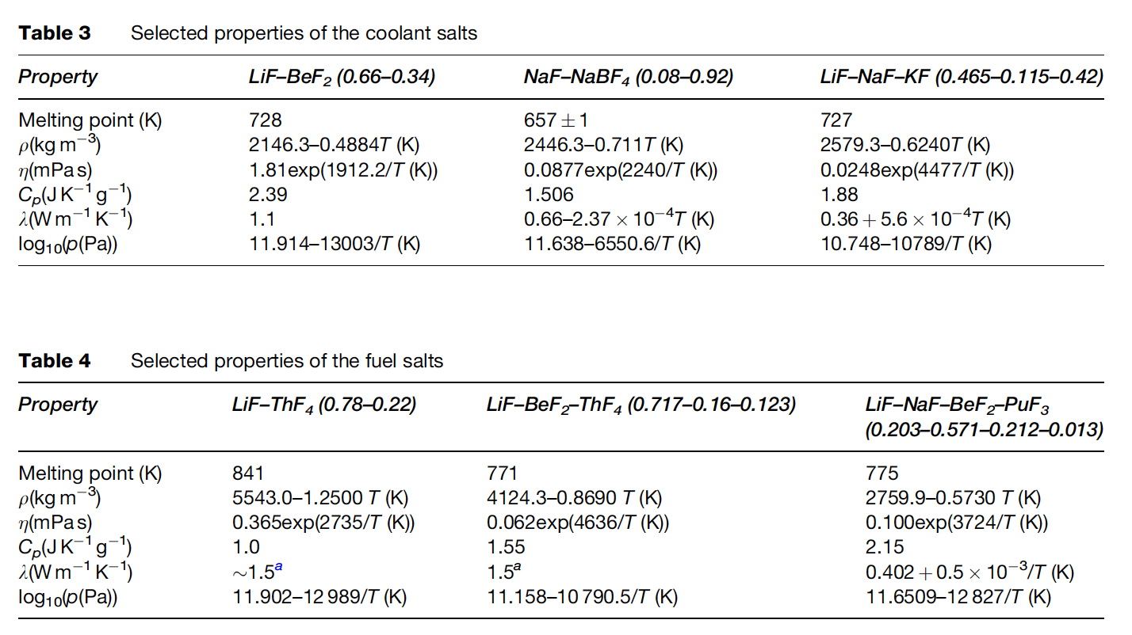
MSR Fuels
The fuel in the MSR must fulfill several requirements with respect to its physicochemical properties
These include low melting point, high solubility of relevant species, low viscosity, high heat capacity, high thermal conductivity, low volatility/vapor pressure

Slide 13
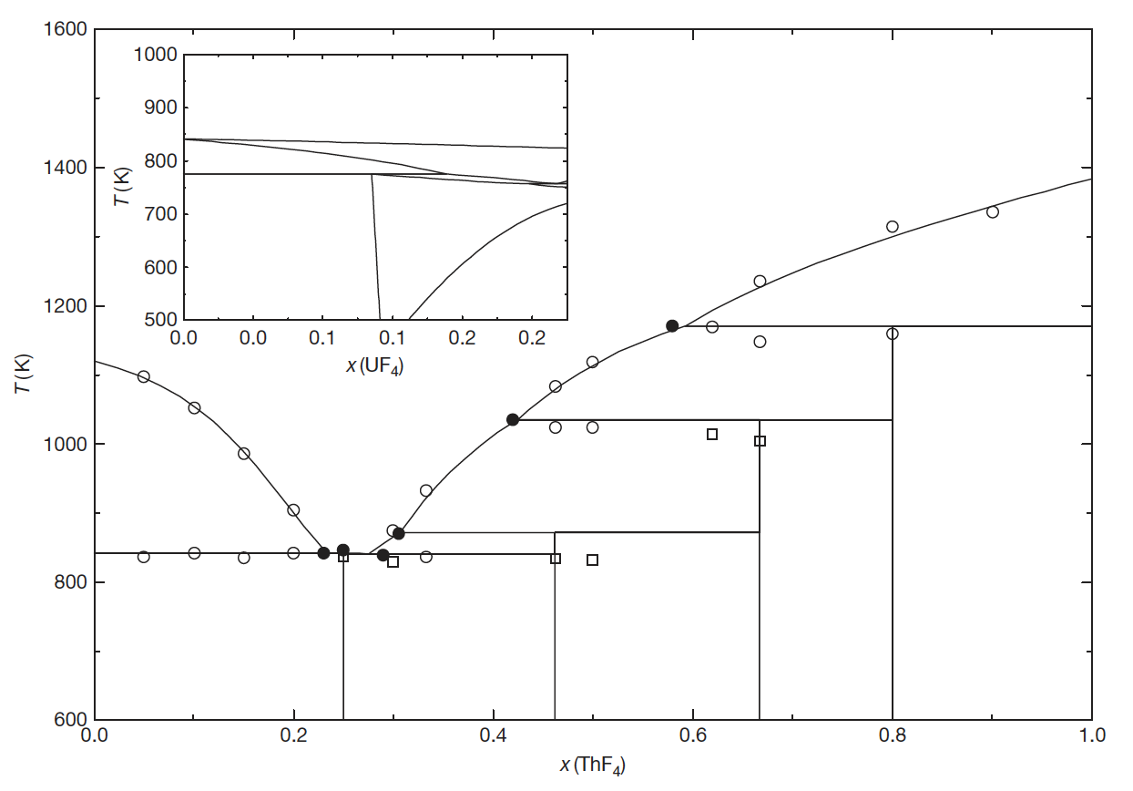
Solubility
The solubility of ThF4 in a matrix of LiF can be deduced from the binary phase diagram
For example, the solubility of ThF4 in a melt of LiF for T 903K (inlet temperature of the MSFR) is between 20.0 and 32.3 mol%
Compositions in this range are, thus, of interest as fuel for MSRs

Slide 14
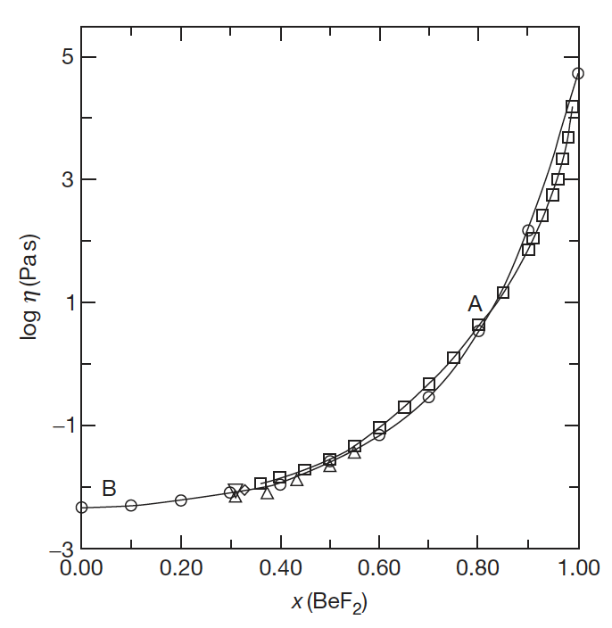
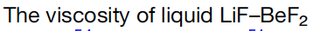
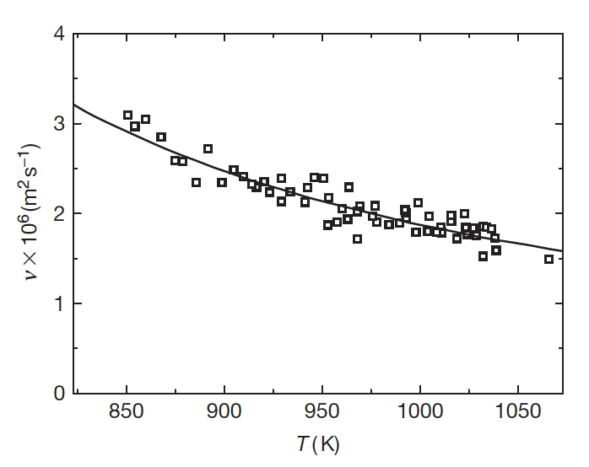
Low Viscosity
The viscosity of a fluid is a measure of its resistance to deformation at a given rate; conceptualized as the internal frictional force that arises between adjacent layers of fluid that are in relative motion
Lower viscosity results in less force to move the fluid at a given velocity
It is sometimes more convenient to utilize the kinematic viscosity, defined as the ratio of the viscosity μ to the density of the fluid ρ

Slide 15
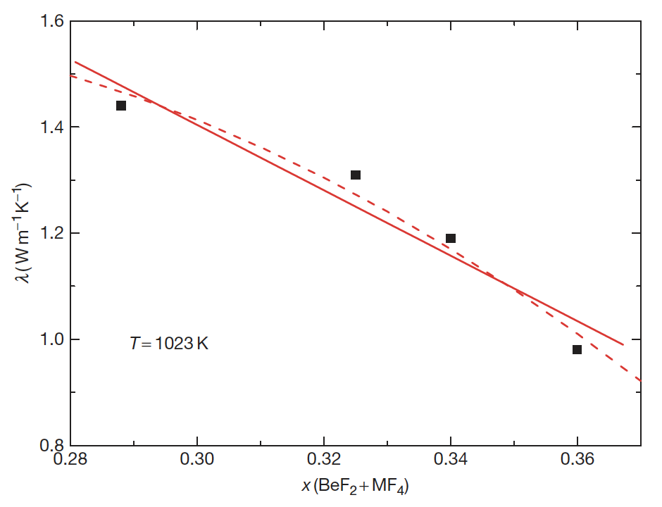
Heat Capacity and Thermal Conductivity
Heat Capacity is defined as the amount of heat to be supplied to an object to produce a unit change in its temperature
High heat capacity enables a small amount of the refrigerant to transfer a large amount of heat very efficiently
The thermal conductivity of a material is a measure of its ability to conduct heat
High thermal conductivity and thermal diffusivity will increase the rate of heat transfer through the fluid

Slide 16
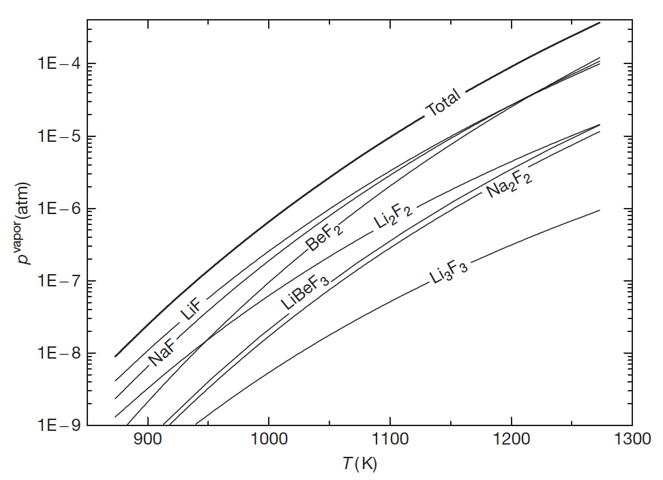
Vapor Pressure (Volatility)
Volatility is a material quality which describes how readily a substance vaporizes
a substance with high volatility is more likely to exist as a vapor, while a substance with low volatility is more likely to be a liquid or solid
Vapor pressure is a measurement of how readily a condensed phase forms a vapor at a given temperature
High vapor pressures indicate a high volatility, while high boiling points indicate low volatility
Salts should have high boiling and low freezing points, in addition to a low vapor pressure (low volatility)

Slide 17
Chemical Compatibility
For any high-temperature application, corrosion of the metallic container alloy is a primary concern
The products of oxidation of metals by molten salts tend to be completely soluble in the corroding media
Due to this solubility, passivation is precluded and the corrosion rate depends on other factors, including oxidants, thermal gradients, salt flow rate, and galvanic coupling
Examination of the free energies of formation for typical alloy components shows that chromium is the most active metal component
Thus, any oxidative attachment to these alloys should be expected to show selective attack on the chromium
Stainless steels, having more chromium than Ni-based alloys, are more susceptible to corrosion by fluoride melts

Slide 18
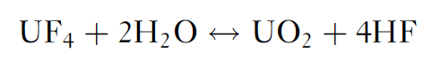
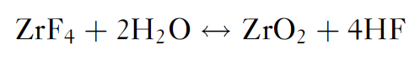
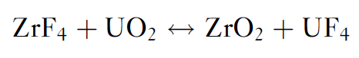
Role of Oxygen Impurities
The behavior of these systems can be significantly affected by the presence of the oxide ion that might be resulting from contamination of the salt system
Actinide oxides, such as UO2, can precipitate out for oxygen concentrations of less than 1E-4
Metal oxides have much higher melting points and therefore appear as insoluble components at operating temperatures
ZrF4 was implemented as an oxygen getter in the original MSRE fuels

Slide 19
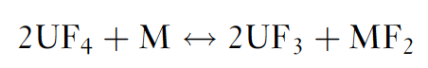
Role of Oxygen Impurities
Redox processes responsible for attack by fluoride mixtures on the alloys result in selective oxidation of the contained Cr
This removal of Cr from the alloy occurs primarily in regions of highest temperature
The rate of corrosion has been measured and was found to be controlled by the rate at which chromium diffuses to the surfaces undergoing attack
Reaction of UF4 with structural metals (M) is strongly temperature dependent, and when the salt is circulated, a mechanism exists for mass transfer and continued attack
This reaction is of significance mainly in the case of alloys containing relatively large amounts of chromium

Slide 20
Control of Chemistry
Avoiding corrosion in an MSR or in fuel-processing units with metallic components is significantly more challenging than avoiding corrosion in clean salt coolant applications
The dissolved uranium and other such species in the fuel salt result in the presence of additional corrosion mechanisms
In clean salt applications, these types of corrosion mechanisms can be reduced or eliminated by (1) using purified salts that do not contain chemical species that can transport chromium and other alloy constituents or (2) operating under chemically reducing conditions
Redox control could be accomplished by including an HF/H₂ mixture

